Slide 1
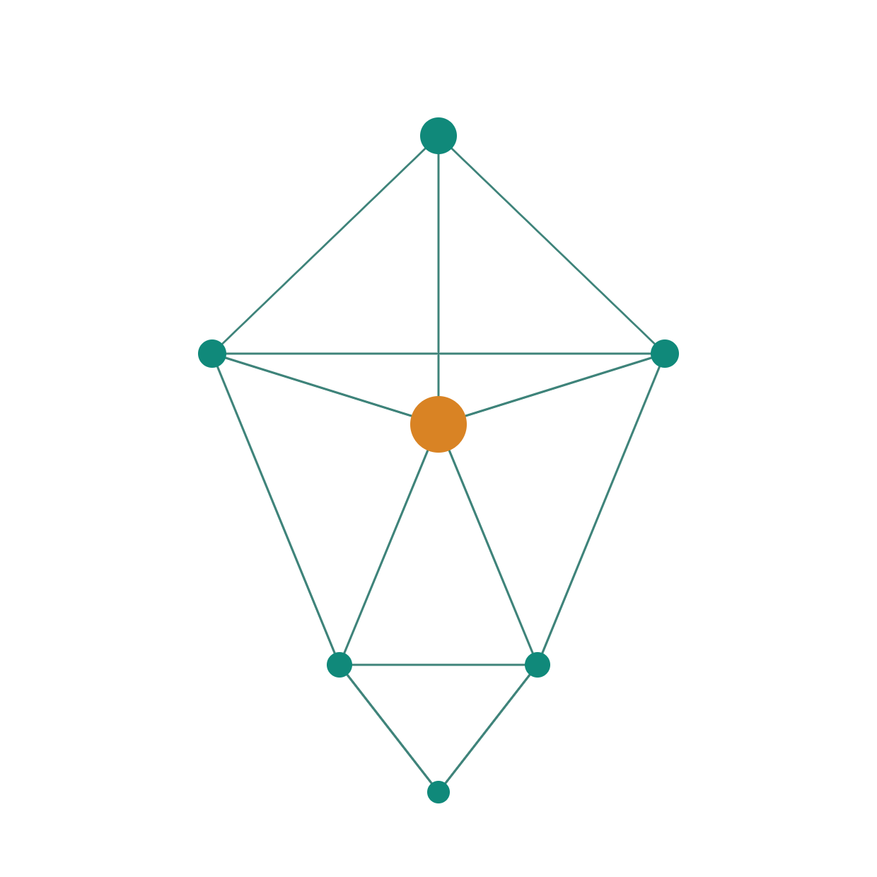
ARCHITECTURE REVIEW BOARD
Graph-Powered Intelligence
Two systems. One architectural approach.
Built on TigerGraph.
Practice Management
iPerform
40M vertices · 104M edges · live today
Notes:
Opening frame. Two systems, one approach. The demo later is what makes the rest credible.

Slide 2





The problems we are solving
Logic locked in code
Inquiries take weeks
Revenue not explained
Rules hardcoded in SQL
Only technology can change them
Each change is a release
Manual investigation
Spans several systems
Depends on who knows
Dashboards show movement
Not where money flowed
Explained by hand, after
Users under-served
Questions unanswerable
TWO QUESTIONS WE CARRY
Advisors, MDWs, DDWs, RDWs
No peer comparison
No next best action
Opportunities unsurfaced
Real questions span time
And relationships
Rows cannot answer them
Simple. How did my revenue change last month, and why?
Complex. Which households hold this product, were recommended it while their goal was conservative, and by which advisor?
Every one of these is a relationship problem. That is what determines the architecture.
Notes:
Lead with their pain, not our features. The last card sets up the two questions carried through the deck.

Slide 3





The value we deliver
Speed to market
Time to resolution
Productivity
Revenue and control
Trust
Document to executable in days
Business authors in plain language
No release cycle
Ask, do not query
Answers with evidence attached
Minutes, not weeks
Movement explained monthly
Coaching on own numbers
Acting, not searching
Every number from the graph
Every claim cited
Every run replayable
Opportunities surfaced
Exceptions caught pre-payout
One consistent reading
The value is not that it is intelligent.
It is that it is intelligent and provable.
Notes:
Five value pillars. Trust is visually separated because it is the one an ARB cares about most.

Slide 4



How we solve it
Rules move from code to content
Exceptions and Variances are rules
From documents — extracted with citations to the passage
From natural language — a sentence, compiled into a query
Authored by business or technology; neither writes SQL
Exception
Variance
Threshold ±
Denominator
Revenue · NNM · NCF
Reason code
Grain
Two types; everything else configured by the author. A new exception is a rule someone writes, not a release.
Computation moves to the graph
Answers move to conversation
Aggregation, filtering, ranking, traversal and as-of state run in the database
The application receives results, not raw data
Technology and business stop writing queries to investigate
They ask; the agent traverses and assembles the evidence
Minutes instead of days or weeks
Insights, drivers, opportunities — source data completes, generation fires. No human involvement.
Rules — document uploaded or rule written. Reviewed, then approved before publish.
Autonomous where the input is data. Gated where the output changes how people get paid.
Notes:
Four shifts. The two trigger models at the bottom are the architectural judgement call worth pausing on.

Slide 5

Why a graph
SIMPLE
COMPLEX
How did my revenue change last month, and why?
Which households hold this product, were recommended it while their goal was conservative, and which advisor recommended it?
Aggregate this month against last. Decompose into volume and deal size. Attribute across products and accounts. Identify which accounts arrived, left or transferred.
Advisor → households → accounts → holdings → product. Then recommendation → the goal as it stood on that date → the advisor.
Four aggregations and a set comparison — resolved in the database.
Five hops and a point-in-time condition.
A vector search cannot answer the second question. It retrieves similar text. The question is about who is connected to what, and when.
Memory is relationships
Grounding needs traversal
Governance is topology
A fact is useful only linked to its source, what it superseded, and who it applies to
Real questions are multi-hop and time-bound; similarity search stops where they begin
Entitlements, lineage and as-of state are all relationship questions
The industry converged on graph-augmented retrieval because vector-only retrieval plateaus exactly where relational and temporal questions start.
Notes:
The pivot slide. Everything before is the problem; everything after is the answer.

Slide 6









Why TigerGraph
Nine capabilities that decide this workload
Massively parallel
Native vectors
Hybrid retrieval
Every query runs on all partitions at once
Scale by adding machines
Embeddings on the vertex, indexed
Vector and graph commit together
Search scoped by a traversal, then expanded
Elsewhere: two systems, one join
Accumulators
50+ algorithms
Multiple graphs
Totals carried as the query walks
Attribution becomes one query
Centrality, community, ranking, paths
Open — scope any to a date
Separate governed views, one dataset
Independent access control
Time-aware
SQL-familiar GSQL
Enterprise controls
Relationships carry validity periods
Query the graph as of any date
SQL conventions — readable day one
Builds on skills we already have
Row policies, ACID, HA, replication
Online schema change · EKS operator
Today we use a fraction of what the engine does. The target state uses the capabilities that have no relational equivalent.
Notes:
Nine cards. Vector storage and enterprise controls are here because the ARB will ask both anyway.

Slide 7

TigerGraph vs Neo4j
Both as self-managed deployments on AWS, against this workload
 | TigerGraph | Neo4j
Parallel execution | Native MPP — graph and compute partitioned across the cluster | Topology on a single shard; properties distributed
Audited analytical scale | Audited at every tested scale, to 10,000× our data volume | No audited result at this benchmark
Query expressiveness | Accumulators — path-aware aggregation in a single pass | Procedure chains or application-side loops
Vector and graph | Distributed index per partition, composable with traversal in one query | Vector index queried, then joined separately
Multiple graphs, one dataset | Native — shared vertex types across named graphs | Separate databases; entities duplicated or federated
Algorithm library | Open, customisable, distributed | Fixed procedures, single-machine projection
Query language | GSQL — SQL-like syntax, familiar to existing developers | Cypher — a new paradigm, dedicated training
GraphQL API | Served natively from the database — no resolver tier to build | Library generating a schema and resolvers you host
Licence model | By data capacity | Per core
Licensing by data capacity rather than per core means analytical headroom does not multiply the licence. Adding compute for month-end processing costs infrastructure, not licence — and the gap widens as cores are added.
Aggregation-heavy, multi-tenant, and joining semantic retrieval to traversal — the stronger fit on capability and the more favourable model on cost.
Notes:
Nine rows, every one chosen because it maps to something this workload actually does.

Slide 8
TigerGraph capability to our use cases
Capability | What it enables
MPP execution | Firm-wide evaluation in one pass
Deep traversal | Household discovery · book transfer
Accumulators | Attribution · rule evaluation
Hybrid vector + graph | Q&A grounded in this client's holdings
Ranking · similarity | Peer ranking · advisor cohorts
Centrality | Influence networks · key clients
Community detection | Household resolution · segmentation
Link prediction | Cross-sell · churn · next best action
Temporal · as-of | Client 360 on any date · suitability
Path finding | Why a recommendation was made
Anomaly detection | Fee leakage · variance outliers
Pattern matching | Conflicting rules · orphan accounts
WORKED EXAMPLE
Where does this advisor rank against peers, and who moved most this quarter?
1 · Similarity groups advisors into peer cohorts by book, tenure and product mix
2 · Aggregation computes credited revenue per advisor within cohort
3 · Ranking assigns position and percentile inside each cohort
4 · Temporal comparison finds the largest quarter-on-quarter moves
Four algorithms · one query · no data leaves the database. The application receives a ranked list, not five thousand rows.
Everything on the left ships with the engine. Everything on the right is a product decision.
Notes:
The worked example is the slide. Four library algorithms composing into one answer.

Slide 9


Temporal graph and context graph
What makes agents auditable rather than merely fluent
Temporal knowledge graph
Context graph
What was true, and when
What the agent knows, and where it came from
The problem it solves
The problem it solves
Why was I paid this in April? — the plan, hierarchy and rule have all changed since
Was this recommendation suitable? — judged against the goal at the time, not today
What did we know when we decided? — the regulator's question
Agents that forget what was already discussed
Answers that ignore prior decisions and outcomes
Coaching that repeats advice already rejected
No way to show why the agent said what it said
Five memory types, linked
What it gives us
Client 360 as it stood on any date
Rule and plan version in force when a payment was calculated
Advisor hierarchy as it existed on a given date
Money-in-motion across rolling windows
Conversation
Semantic
Episodic
Procedural
Preference
Memory is useful only when linked — this fact came from that interaction, superseded this one, applies to that household. A vector store holds memories side by side with no relationship between them.
Relationships carry validity periods, so one query asks for the graph as of any date. Accumulators apply the filter while traversing, not after.
Temporal answers when. Context answers why. Together they turn a fluent assistant into an auditable one.
Notes:
The regulator question on the left is the one that lands hardest with a bank audience.

Slide 10

Scale and performance
Built for where the data is going, not where it is today
WHERE WE ARE
WHERE IT GOES
WHAT THE ENGINE HAS DEMONSTRATED
40M
Billions
Independently audited at every published scale — to 10,000× our data volume. The only graph database with audited results at this benchmark.
vertices · 104M edges
of records
12.4M transactions
Full history, all business lines
72.6 billion vertices · 539.6 billion edges · 36 TB on a 40-machine cluster
Three-month window
Multi-year retention
Half of complex analytical queries completed under one minute
The remainder in one to eight minutes
Roughly 1,800× our current data volume
Parallel by default
Scale by adding machines
Compression
Workload separation
Every query executes across all partitions simultaneously
Repartitioning is an online operation, not a migration
The stored graph is typically smaller than the raw input
Advisor queries and firm-wide batch on separate capacity
At today's volume a modest cluster is sufficient. The reason to choose this engine is that the same architecture still holds at a thousand times the data.
Notes:
The 1,800x comparison is the number to land. It answers "will this hold in production" before it is asked.

Slide 11

Cost comparison
Enterprise, self-managed on AWS · every figure below is published by the vendor or arithmetic from it
30%
13%
8×
0%
lower list rate, standard tier
lower list rate, high availability
higher published capacity ceiling
difference in AWS infrastructure cost
Published by the vendor | TigerGraph | Neo4j
Self-managed Enterprise price | Not published — annual licence by data capacity | Not published — contact sales
List rate, standard | $45.63 per GB-month | $65.00 per GB-month
List rate, high availability | $127.76 per GB-month | $146.00 per GB-month
Capacity ceiling published | 4,096 GB per workspace | 512 GB on AWS · 128 GB standard tier
Free edition | 300 GB graph and vector, single server | Community Edition, no clustering or hot backup
How the rate is derived
Example load, identical on both
TigerGraph publishes compute by workspace: 2 vCPU / 16 GB at $1 per hour. That is $730 per month, or $45.63 per GB-month — and the rate is identical at every tier up to 512 vCPU / 4 TB. The HA figure applies the published 2.8 multiplier. Neo4j states $65 and $146 per GB-month directly.
100 GB graph · 3 memory-optimised EC2 nodes on EKS · 48 vCPU, 384 GB RAM · gp3 storage and backup. Infrastructure runs roughly $25k–30k a year on demand, 35–66% less with Reserved Instances or a Savings Plan. Neither engine changes that figure.
Infrastructure is not the differentiator — it is the same on both. The licence is, and on the only rates either vendor publishes, TigerGraph sits 30% below Neo4j at standard tier and 13% below at high availability, with eight times the published capacity ceiling.
Rates from tigergraph.com and neo4j.com pricing pages. Self-managed Enterprise is quoted by negotiation at both vendors; published list rates are used here as the vendors' own statement of relative position.
Notes:
Every number here is either on a vendor pricing page or one division away from it. The derivation is shown so it can be checked live.

Slide 12




Cost optimisation
Three levers, applied from day one
TigerGraph
LLM
Platform
Right-size first — add nodes when measured, not anticipated
Reserved Instances and Savings Plans on committed compute
Separate read capacity so batch stays off the serving tier
Graph holds relationships; detail stays relational
Off-peak scheduling for algorithms and embeddings
Non-production stopped when idle
Compression cuts storage and memory
Right-size the model per role — small models screen and classify
Context engineering is cost engineering — ranking, filtering, pruning and compression happen before the call
Compute once, serve many — insights generated once per advisor
Embeddings at ingest, never per query
Caching for repeated questions
Structured outputs cut retries · batch generation
Compute in the database — fewer rows move, so the application tier stays small
Asynchronous execution sized to the job, not always-on capacity
Autoscale to zero in non-production
Cost per query, per token and per model tracked alongside latency
One platform carries both systems — no second licence
The largest lever is architectural. Computing in the graph and engineering the context keeps both the infrastructure and the token bill small as the data grows.
Notes:
Three levers. The architectural point at the bottom is the one that compounds.

Slide 13




What we are building
Two systems. Different domains. The same architectural approach.
Practice Management Dashboard
iPerform
Practice AI
autonomous
iPerform AI
autonomous
Monthly insights, revenue drivers and exceptions at practice and advisor level, triggered when source processing completes. Rules generated on demand from uploaded documents.
Insights, opportunities and recommendations for advisors, generated without user involvement.
iPerform Coach
conversational
Practice Coach
conversational
Coaching, guidance and Q&A grounded in the advisor's own book and outcomes.
Answers questions across all data with context-aware reasoning over relationships — not summaries of a dashboard.
THEY SHARE
Knowledge graph · agent framework · context engineering · governed data access · verification · observability · security
Each with an autonomous engine and a conversational agent, on the same foundation — so the second costs a fraction of the first.
Notes:
The 2x2 is the whole point. Two systems, same shape, shared foundation.

Slide 14
What we have built
Running today, against production data
40,047,519
104,273,975
12,360,142
5,455
62
graph vertices
graph edges
transactions
advisor cohort
installed queries
APRIL FIRM BASIS, COMPUTED
Against the firm's own report of $403,533,981.62. The difference is advisors outside the defined cohort — verified, explained and reproducible.
$397,389,374.54
WORKING TODAY
Document upload and rule extraction with citations
Rule compilation, review, publish and versioning
Firm and advisor revenue with driver attribution
Account lifecycle — new, lost, retained, transferred
Exception detection across the full cohort
Non-credited revenue analysis by reason code
Conversational assistant with evidence drill-down
This is not a prototype. It is the first system of the architecture, running on real data.
Notes:
DEMO GOES HERE. Show rule extraction from a document, then a complex conversational question with drill-down.

Slide 15









Architecture
Presentation at the top. Data at the bottom. Nothing skips a layer.
Presentation
Dashboard · advisor view · documents and rules · coaching · trace
Services
Request handling · export · delivery · REST, GraphQL and MCP access
request
down
Agents
Reasoning, extraction, narration — never calculation
Context Engineering
Retrieval · ranking · filtering · pruning · compression · assembly · citation binding
Guardrails & Verification
Input screened before the answer · every figure verified before display
Data Access
Named, governed queries — the only path to data
result
up
Knowledge Graph
TigerGraph — aggregation, filtering, ranking, traversal and as-of state all execute here
The graph computes. The agents interpret. The verification layer decides what is allowed out.
Notes:
Seven layers. The dark band at the bottom is deliberate — the graph is the foundation everything rests on.

Slide 16





The agent layer
Six specialist agents. Each with a defined boundary.
Rule Extractor
Rule Compiler
Insights Agent
Reads plan documents, proposes drafts with citations
Compiles an approved rule and audits it against published rules
Investigate selects catalogued queries · Narrate writes from findings
Proposes only — never publishes
Once at approval — blocks conflicts
One queries, the other writes — never both
Guidance Agent
Practice Coach Agent
Guardrail Agent
Coaching and next best action on the individual's own numbers
Conversational answers across data and relationships
Screens every input; verifies every output before it is shown
Retrieved guidance — never invented advice
Scoped to the user's entitlements
Fails closed
The investigation phase can query but cannot write. The narration phase can write but cannot query. That separation is why a generated narrative cannot invent a number.
Notes:
Six agents. The boundary line at the bottom is the anti-hallucination argument in one sentence.

Slide 17


North Star architecture
Five layers. Each depends on the one below it.
LAYER 5
Experience
Practice Management
iPerform
Conversational agents
Export & delivery
LAYER 4
Intelligence
Autonomous insights
Prediction & recommendation
Coaching
Opportunity scoring
LAYER 3
Agent platform
Orchestration
Context engineering
Evaluation & trust
Governed tool access
build
order
value
order
Temporal knowledge graph
Context graph & memory
Vector index
LAYER 2
Knowledge
Algorithms & embeddings
LAYER 1
Foundation
Data & knowledge ingestion
Security & governance
Observability
AWS platform
Bottom-up is the build order — nothing above works without what is beneath it. Top-down is the value order — the business sees Layer 5; Layer 1 is what makes it trustworthy.
Notes:
Read it twice. The knowledge layer is outlined because that is where TigerGraph sits and where this approval matters.

Slide 18





North Star implementation journey
Now
Next
North Star
Built and running
In design
Target state
Practice AI and Practice Coach on production data
Rules extracted from documents with citations
Firm and advisor revenue with driver attribution
Exception detection across 5,455 advisors
Conversational assistant with evidence drill-down
iPerform AI and iPerform Coach on the same platform
Content Cloud integration for document processing
AWS production deployment
Autonomous monthly generation
Opportunities and coaching
Prediction and recommendation engine
Graph embeddings and behavioural models
Full temporal knowledge graph with as-of history
Agent memory across conversations and outcomes
Continuous learning from outcomes
Each stage reuses the foundation beneath it. That is the argument for building it this way.
Notes:
Honest about what exists. The Now column is the credibility; the North Star column is the ambition.

Slide 19

Production on AWS
Built for the firm's environment, not for a demonstration
Concern | Production approach
Edge & identity | Corporate authentication; entitlements enforced at every layer, including in the database
Application tier | Containerised services, independently scaled by workload profile
Long-running analysis | Managed asynchronous execution with scheduling, retry and resumption
Knowledge graph | TigerGraph on Kubernetes — HA across zones, cross-region replication, point-in-time recovery
Operational state | Managed relational store for rules, versions, runs and conversation history
Documents & retrieval | Content Cloud parses, chunks, embeds and indexes; consumed through governed API access
Observability | Tracing, metrics, logs and audit across agents, models, queries and data
A firm-wide evaluation across 5,455 advisors cannot complete inside a web request. In production it does not try to — it runs as managed background work with progress, retry and resumption.
API STRATEGY
GraphQL — served natively from the database. Consumers shape their own queries; no resolver tier to build or maintain
REST — service endpoints aligned to existing bank standards
MCP — agents receive governed tools, not query access
Detailed AWS design follows separately. Every architectural decision here assumes production.
Notes:
Detailed AWS design is a separate session. This slide establishes that production was designed for, not retrofitted.

Slide 20
GraphQL, served by the graph
One request where REST needs four
ADVISOR 360 — ONE CALL, FOUR HOPS
Why it matters here
Relationships in the schema become traversals in the query
Generated from the schema — no resolver tier to build or host
Included in the licence we are already buying
query AdvisorBook($sid: String!) {
Advisor(advisor_sid: $sid) {
advisor_name credited_revenue
advises { Household {
household_name total_aum
owns { Account {
account_key is_managed
holds { Product { name } }
} }
} }
}
}
Where we use it
Advisor 360 — the relationship tree in one call
Downstream teams — no new endpoint each time
Federation — joins an enterprise layer as a subgraph
Returns the advisor, every household, account and product in one document — shaped exactly as the screen needs it.
Governed
Authentication and authorisation at the database
Row policies beneath the query — scoping cannot be bypassed
Query depth and complexity limits
Graph, vectors, algorithms, MPP and GraphQL in one platform and one licence — rather than assembled from several.
Notes:
For anyone new to GraphQL on a graph database. The point is the missing resolver tier.

Slide 21
APPENDIX
Context engineering
An agent given everything produces noise. An agent given the right context produces a defensible answer.
1
2
3
4
5
6
7
Retrieval
Ranking
Filtering
Pruning
Compression
Assembly
Citation
Candidates from graph, documents and memory
Relevance, recency and business importance
Business rules, entitlements, thresholds
Redundant and superseded content removed
Long content into high-signal form
Final package with structure and metadata
Every fact carries its source
Context sources
Why it also controls cost
The knowledge graph — entities, relationships, as-of state
Plan documents and policies, via governed retrieval
Conversation and agent memory
Advisor and household history · computed insights and outcomes
Ranking, filtering, pruning and compression run before the model call
The model sees a fraction of the candidate context
Quality and cost improve together, not in tension
Every claim an agent makes traces to a passage or a query result. Nothing is generated from memory alone.
Notes:
Appendix. Shown if the ARB asks how context is assembled.

Slide 22
APPENDIX
Trust and verification
A missing answer is acceptable. A confident wrong number is not.
Before the agent answers
After the agent answers
Every message classified, then admitted or blocked
Every figure must appear in the retrieved data
Roundings and verified sums or differences permitted
Percentages pass only where numerator and denominator are named together
Evidence rows copied from query results, never generated
Coverage computed and flagged when out of range
Literal prompt-leak check on every answer
Clean
Prompt injection
Jailbreak
Query injection
Social engineering
Data exfiltration
Off topic
Fails closed — doubt blocks rather than admits.
On failure
Why deterministic, not a judge model
The unverified figure is surfaced, not displayed
One retry on the fallback route
Then an honest failure state, recorded on the run
The gate reproduces every piece of arithmetic. Anything unreproducible does not pass — no judgement call is involved. In a compensation system that is the only standard that holds up to audit.
Notes:
Appendix. This is the slide that answers "how do you know the AI is not making numbers up".

